Slide 1
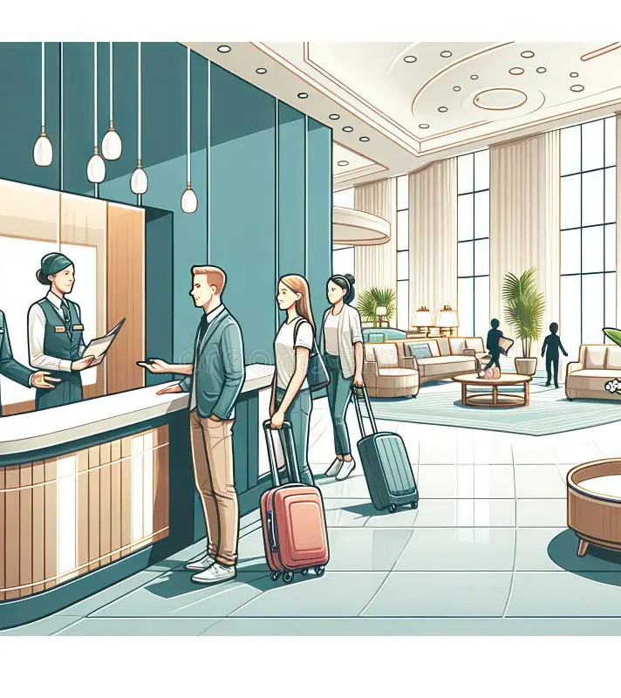
Hotel Operations Management System
A Web-Based Hotel Management Application
Presented by:
Hadiyal Nilesh
Computer Science & Engineering
7-Slide Summary | Option A (Current Progress)

Slide 2
Abstract
What this project is about
Hotel Operations Management System
This project is a web-based system intended to centralize daily hotel operations into one platform.
The complete solution will cover rooms, bookings, menu items, food orders, and billing/invoicing.
In the current phase, the foundation is implemented: Home page UI, user Login/Register, and backend setup.
The system is designed using Node.js + Express (MVC), MongoDB (Mongoose), and EJS for server-side rendering.
Future phases will add operational modules and enhancements such as role-based access and reporting.

Slide 3
Problem Statement
Why this system is needed
Problems in Manual Operations
Proposed Solution
Booking mistakes (overbooking / wrong dates / wrong room).
Slow coordination between front desk and kitchen.
Billing errors due to missed charges and manual calculations.
No single dashboard to view live status across departments.
A centralized web application for hotel operations.
Secure login system to protect access.
Structured modules for Rooms, Booking, Orders, Billing.
Improved accuracy, speed, and visibility for staff.

Slide 4
Project Overview
What we are building & current phase
Objective
Current Phase
Centralize hotel operations into one web-based system.
Reduce manual errors in bookings, orders, and billing.
Improve operational speed for front desk & admin staff.
Authentication module and base system setup.
UI foundations: Home + Login + Register.
Preparing modules for Rooms, Booking, Orders, Billing.

Slide 5
Completed Work
What is implemented so far
Home Page
Authentication + Backend Setup
Modern UI layout & navigation structure.
Intro sections for system purpose and flow.
Links prepared for upcoming modules.
User registration and login flow.
Password hashing with bcrypt.
Session-based authentication (express-session).
MongoDB connection using Mongoose.
MVC folder structure for scalability.

Slide 6
System Architecture
Technology stack and MVC flow
Technology Stack
MVC Request Flow
Backend: Node.js, Express.js
Frontend: EJS, CSS, JavaScript
Database: MongoDB, Mongoose
Security: express-session, bcrypt
Browser (User)
Routes (Express)
Controller Logic
Model (Mongoose)
MongoDB

Slide 7
Future Development Plan
Next modules to build
Modules Under Development
Enhancements (Future Scope)
Rooms Management (CRUD + availability)
Booking Management (reservations + history)
Menu & Order Management (kitchen queue)
Billing & Invoice (auto-calculation + PDF)
Dashboard analytics (overview and KPIs)
Role-Based Access (Admin / Staff)
Payment gateway integration (UPI / Card)
Reports (occupancy, revenue, top items)
Real-time notifications (orders / bookings)

